Slide 1
How to wordpress

Slide 2
1.
What is LAMP?
(not the light source)

Slide 3




Linux, Apache, Mysql, PHP
Linux
The operating system which hosts the server
Apache
The front-end of the server, which hosts your files. It processes requests and uses HTTP to provide basic web functionality
Mysql
SQL: Structured Query Language. Mysql is the database that can contain vital information such as user login
PHP
PHP stands for PHP Hypertext Processor (wow recursion!). It is a scripting language that has dynamic functionality such as pulling data out of Mysql

Slide 4
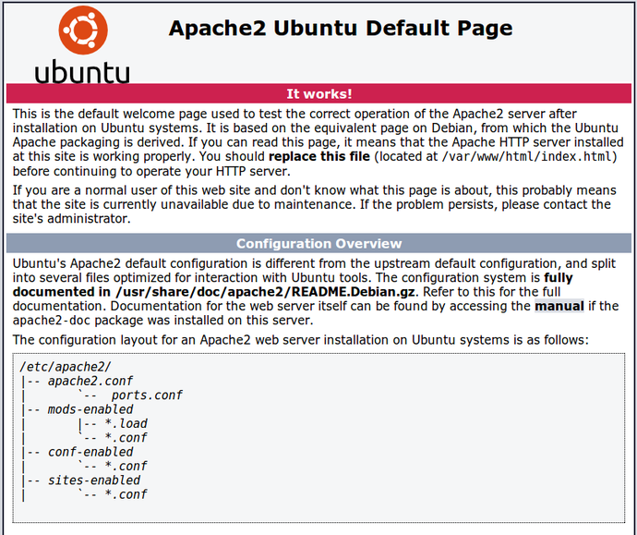
Standalone apache
All you can do is display/format text. Wow kinda boring right?
What you see upon default installation

Slide 5
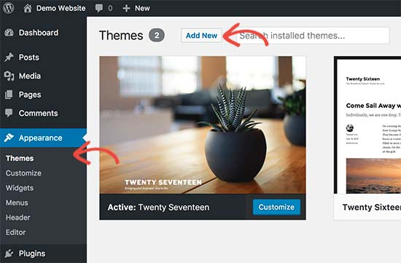
Apache but now with Mysql and PHP
Now you can easily create pages, users, themes, etc. Amazing :D
Mysql: stores the posts, comments, etc
PHP: communicates with Mysql
Wordpress setup

Slide 6
2.
What is Wordpress?
And where does it fit into our lamp stack?

Slide 7

Wordpress
CMS: content management system
Basically, allows you to create blogs, pages, etc without ever touching any HTML or CSS
Other CMS platforms:
Magento: E-com
Squarespace: you’ve probably seen it in an annoying youtube ad

Slide 8
3.
Where to configure?
Oh noes the hard part :(

Slide 9

Apache2
/var/www/
Generally, where all of the hosted files are stored (although location may vary)
/etc/apache2/
Where all of your configuration files are stored

Slide 10
A closer look at /etc/apache2/
apache2.conf: the main configuration file
conf-available/: any additional config files. Are not active until enabled
conf-enabled/: allows those extra config files to be processed
mods-available/: available modules
mods-enabled/: enabled modules
sites-available/: available sites
sites-enabled/: all of the active sites that apache is hosting

Slide 11
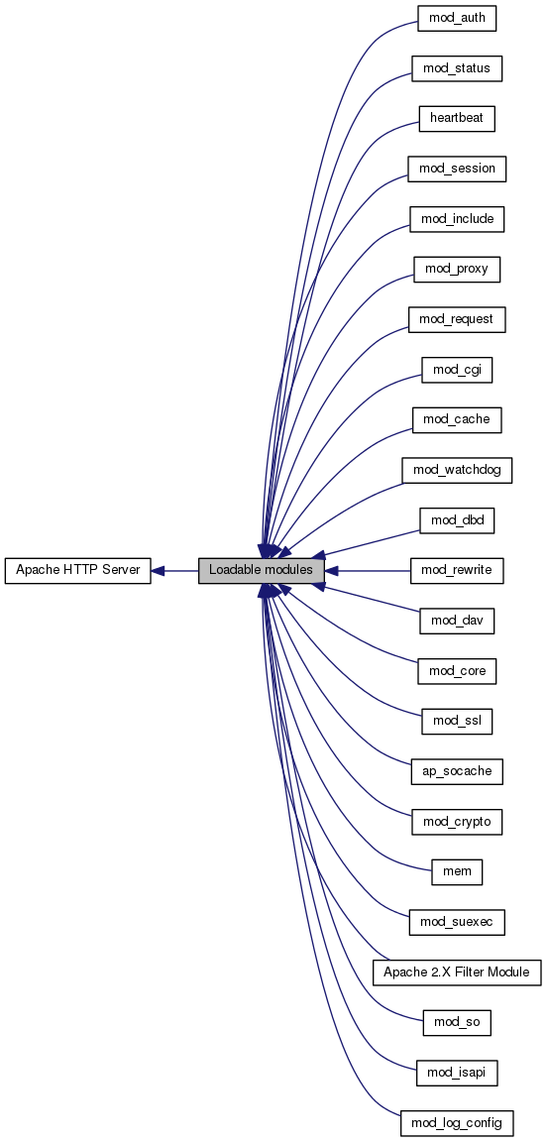
What are modules?
Provides extra functionality to apache
Ex: perform SSL encryption using a2enmod ssl (and a couple extra configs)

Slide 12
PRO TIP!
Always check your sites-enabled in case you are hosting additional info which can lead to system vulnerabilities

Slide 13

Mysql
/etc/mysql/mysql.conf.d/mysqld.cnf
Organized by sections, which are indicated with brackets
The main one is [mysqld]
d stands for daemon, which is just another way to say service

Slide 14
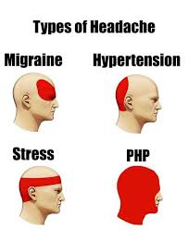
PHP
/etc/php/7.0/cli/php.ini
Note: this only works if your linux version supports PHP version 7

Slide 15
Side note:
Some configuration files might be different depending on your linux distro/version. These are for 16.04

Slide 16
4.
Accessing and configuring wordpress
It’s easier than expected

Slide 17
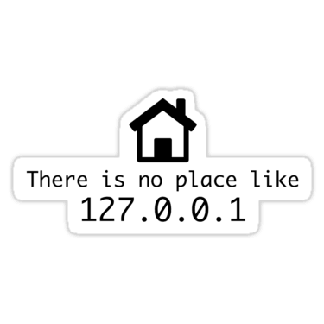
Accessing your site
Go to your browser and search “localhost”
Your system translates localhost to 127.0.0.1 in /etc/hosts
Aka the loopback address
ALWAYS DO THIS AFTER CONFIG
Verify that your site is not only configured, but also FUNCTIONAL

Slide 18
Configuration
/var/www/html/wp-config.php
Not necessarily in /var/www/html/
Contains important info such as the mysql password, which wordpress needs to access

Slide 19
Maintaining your site
In your browser, search for [example.com]/wp-admin
Because you are generally going to be on the server in cypat (instead of configuring remotely), you can search for localhost/wp-admin
Now you can check your users, posts, etc
Pro tip: check the plugins! Sometimes exploits are hidden here!
Everything is GUI based, so pretty self-explanatory

